Slide 1
Pakistan’s Pharmaceutical Industry
Growth, Challenges and Issues

Slide 2
Basic Information
750 firms, but Government’s regulatory authority puts the number at 639 (geotagged)
Estimated size is $3.1 billion or a bit more, not even 0.3% of the global volume (which is more than $1.1 trillion)
In terms of product sales, highly skewed structure: top 100 firms have 95 percent of the market share (top 50 firms having a share of 89 percent). Remaining 650 firms 5 percent
Out of the total sales, 80 percent products manufactured in Pakistan while 20 percent imported

Slide 3
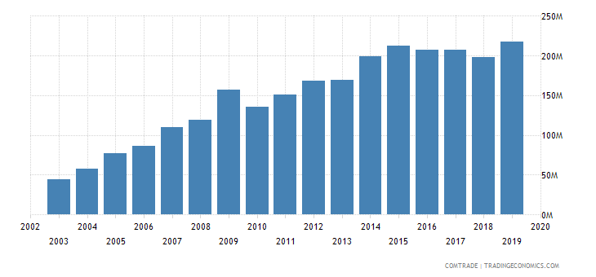
Exports in 2018-19= $211 million. India’s pharmaceutical exports were $19.6 billion in the same year
The industry employs 150,000 individuals directly, and 300,000 people indirectly

Slide 4
95 percent of the raw material and Active Pharmaceutical Ingredients (APIs) for manufacturing are imported, from China and India
MNCs produce ‘patent’ or ‘originator’ brand medicines, while domestic firms produce ‘generics’ (cheaper versions of originator brands)
MNCs used to have around 60 percent of the market share. Now, their market share is hardly 40 percent. Domestic pharma companies now have a 60 percent share
FDI Negligible. In 2018-19, it was approximately $26 million. FDI in Indian pharma industry approximately $26 billion at the same time
Drug Regulatory Authority of Pakistan (DRAP) main regulator

Slide 5
Issues plaguing growth of the sector
Although the Compound Annual Growth Rate (CAGR) of Pak pharma industry stood at a respectable 12% in last 5 years, it does not mean that the industry does not face any issues and is in a healthy state
In fact, it has performed below its potential for long
Main reason: heavy government regulation. No industry in Pakistan is as heavily regulated in Pakistan as pharmaceutical industry, with initial registration to final retail price, all decided by government

Slide 6
Pricing- The most contentious issue
No concept of market forces determining prices. DRAP finalizes the sale price, which has to be approved by the cabinet. Thus, pricing is a political decision
The most notable instance: complete ‘prize freeze’ on medicine prices from 2001 to 2013. Prices of only few medicines allowed to increase (‘hardship’ cases), while most remained the same for all these 12 years
In the same time, cost of production increased manifold

Slide 7
Pricing- The most contentious issue
Two new pricing policies- 2015 and 2018, the latter implemented after Supreme Court’s order in a case involving price increase of medicines
The 2018 policy uses ‘reference’ pricing, and allows increase relative to CPI (cap of 7% for ‘essential’ medicines and 10 percent for all others)
For industry, 2018 policy much better option compared to prize freeze type policies
However, no smooth sailing under this policy too. A special audit, in lieu of controversy surrounding granting price increases in 2019, claimed to find several ‘anomalies’ in pricing methodology
All this means is that the saga surrounding pricing medicines has not abated, and we will see more litigation in the future

Slide 8
The fallout from administered pricing
Out of the approximately 70,000 registered medicines, hardly 10,000 being produced: it became financially unfeasible to produce many medicines b/c cost>retail price due to administered price policies
Drug shortages, especially of life saving medicines, became more pervasive
Many medicines, previously produced domestically, had to be imported, sold at three times or more
No significant FDI coming in
Prize policies was main reason many MNCs left the country or divesting away from manufacturing medicines
Producers turning to other methods to escape the fallout, like registering medicines under ‘alternate’ or ‘nutraceuticals’ category, with relatively deregulated prices

Slide 9
Other issues confronting the industry
‘Toll’ or ‘contract’ manufacturing- It’s a global practice, which helps utilization of underutilized capacity in pharmaceutical sector. Contract manufacturing in India worth $36 billion, creating jobs and bringing in FDI. However, for unexplained reason, Pakistani regulators have remained averse to the idea of contract manufacturing
Issues related to registration time of drugs (too long, complain the industry). Cases from 2014 still pending for approval by regulator
Official policies leading to loss of nearby markets like Pakistan
No IP protection. That’s a disincentive for research
Lack of quality infrastructure and research, for which government has been charging a tax since 1976
Lack of quality human capital

Slide 10
Regulator
DRAP, founded in 2013, after deaths at Punjab cardiovascular institute due to sub-standard medicines
Formerly, the industry was regulated under the 1976 Act
Three main boards (‘Policy Board’, ‘Licensing Board’ and ‘Registration Board’). There are 14 sub-divisions, tasked with carrying out the work and directions of DRAP
Compared to pre-DRAP, post-DRAP regulator performance has been termed comparatively satisfactory by analysts
However, significant challenges remain

Slide 11
DRAP performance- Challenges
Limited resources, both monetary and qualified human capital. A total of 26 drug inspectors for the whole country
Although the prevalence of sub-standard or poor quality medicines is greatly exaggerated, failure to control continued recurrence of sub-standard or ineffective medicine instances
Provision of quality infrastructure- Not a single FDA approved laboratory in Pakistan, which is the global gold standard in pharmaceutical industry
Non-explanation of all the money collected under Central research Fund (CSR) since 1976. Where did all the money go, where was it spent, how much in total collected from pharmaceutical companies since 1976, etc.?

Slide 12
DRAP performance- Challenges
Continued failure to ensure availability of essential, life-saving medicines. Hardly 15 percent of ‘essential’ medicines are available at public institutions, while 30 percent are available in the private sector (retail, private hospitals, etc.).
Failure to stop deceptive marketing practices, doctor-producer collusion, and over-subscription of medicines by doctors. These not only lead to additional out-of-pocket expenditures, but also pose health risks as increased use of medicines leads to higher resistance against medicines.
Failure to stop selling of generic drugs as ‘branded generics’, which is price differentiation tactic, costing the consumer more.
Shortcomings in ensuring qualified pharmacists dispensing medicines at medical stores

Slide 13
Public perception of the industry
Overall, negative
Chief Justice (CJ) has termed the industry as a ‘mafia’ during a recent court hearing
Print media’s presentation of the industry heavily tilted on the negative side
A minor price increase of Rs. 5, for e-g, is always presented in percentages to garner public anger
Media never mentions that many pharmaceutical firms run charitable intitiatives, and that the industry is one of the top taxpayers in the country

