Slide 1
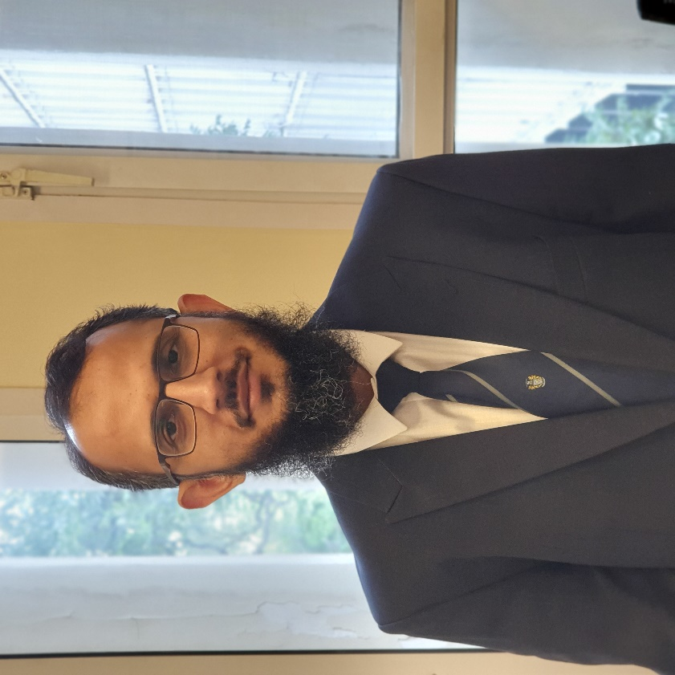
Book LAUNCH Dec 22, 2021 PIDE, Islamabad

Slide 2
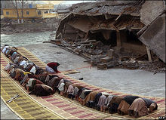
Why a book on the role of the Mosque in Disasters?
People praying in the courtyard of a mosque (in Balakot) building that fell down due to 2005 Kashmir earthquake in Pakistan
Notes:
Religion survived the onslaught of various ideological and political challenges. The humanitarian project is not just a European tradition. It is rooted in the universal behaviour to help other human beings in distress. It has been encapsulated in all faiths, from Dana, one of Hinduism’s and Buddhism’s vital practices, to Islam’s Zakat, and Christian charity. It is no coincidence that local religious organisations are at the forefront of providing relief.

Slide 3
mosque and the 2005 earthquake
Roles during response and relief
1. Initial contact point
2. A space and forum for coordinating response and relief efforts
3. Ensuring the inclusion of the vulnerable
4. Socially integrating force
5. Recruiting of volunteers
Roles during recovery, reconstruction and rehabilitation
1. Support for livelihoods
2. Psychosocial support, spiritual healing and creating resilience
Role influencing preparedness
1. Influence on disaster risk perception

Slide 4
Socio-economic & cultural services of the mosque
Cultural - The bridging cultural gap between different disaster management actors and the local community
Psychosocial - Influence on disaster risk perception and attitude towards disaster preparedness, spiritual well-being, healing and resilience
Economic - Sharing of market information
Social - Women – exclusion and inclusion
Networking with other actors such as civil society, private sector and government organisations and identification of the poor

Slide 5
Mosque and Disaster Risk Reduction
CONNECT
Coordinate implementation of DRR policy and guidance at the local level with communities and other local level stakeholders.
Campaign for spreading awareness about hazards and vulnerabilities at the local level.
Advocate greater investment in housing and public infrastructure among communities by explaining to them the immense value of human life in religious terms.
Inform the local people about state DRR policies, tools and strategies and keep them connected with other such forums.
AND
CONVINCE
Organise meeting of all stakeholders at the local level to assess the implementation of DRR guidelines.
Promote DRR polices and other safe environmental practices for their integration in everyday life routine.
Encourage the establishment of an early warning system, which strengthens capacities and supports recovery processes.
Provide feedback to local DM stakeholders about the status of disaster preparedness in community.
MOSQUE

Slide 6
Opportunities Vs Challenges to engagement with religious institutions
Similarities between goals of religious and secular organisations
Sensitivity
Proselytising, discrimination and neutrality
Fate – Disaster Risk Perception
Opportunities for psychosocial support, spiritual healing, resilience, and charity

Slide 7
Religion, Mosques and Development
The mosque reflected the three core characteristics – community ownership, trust and sustainability – essential to make any development initiative a success.
Mosques in achieving Sustainable Development – Goals (SDGs) - Poverty Reduction, Hunger/Food Security, Health, Education, Gender Equality, Water and Sanitation, Climate Change and others to come.

Slide 8
Practical suggestions
Mosque as a physical and spiritual place with potential for – First Aid, Vocational Training, Youth Counselling, Mental Health Care, Character Building, School Enrolment, Vaccination Drives, Hygiene.
Taking an inclusive and grassroots approach, imams/leaders of areas mosques/churches/temples or other community based religious institutions (or their representatives, service leaders) should be made part of district/sub-district/town level development committees.

Slide 9
key take away
In societies where religion is a defining feature of individual and collective identity, a powerful religious narrative and worldview are likely to permeate, if not prevail, in the socio-cultural environment.
Pakistan as a Muslim majority country has a huge untapped potential in leveraging the institution of mosque to achieve socio-economic and behavioural transformation goals of building tolerant, inclusive, prosperous and a happier society.
For this to happen, worshippers and others need to reform and reimagine the role of the mosque as a dynamic and vibrant community welfare institution with demonstrated community ownership, trust and sustainability.

Slide 10
Thanks for your attention!

